Slide 1
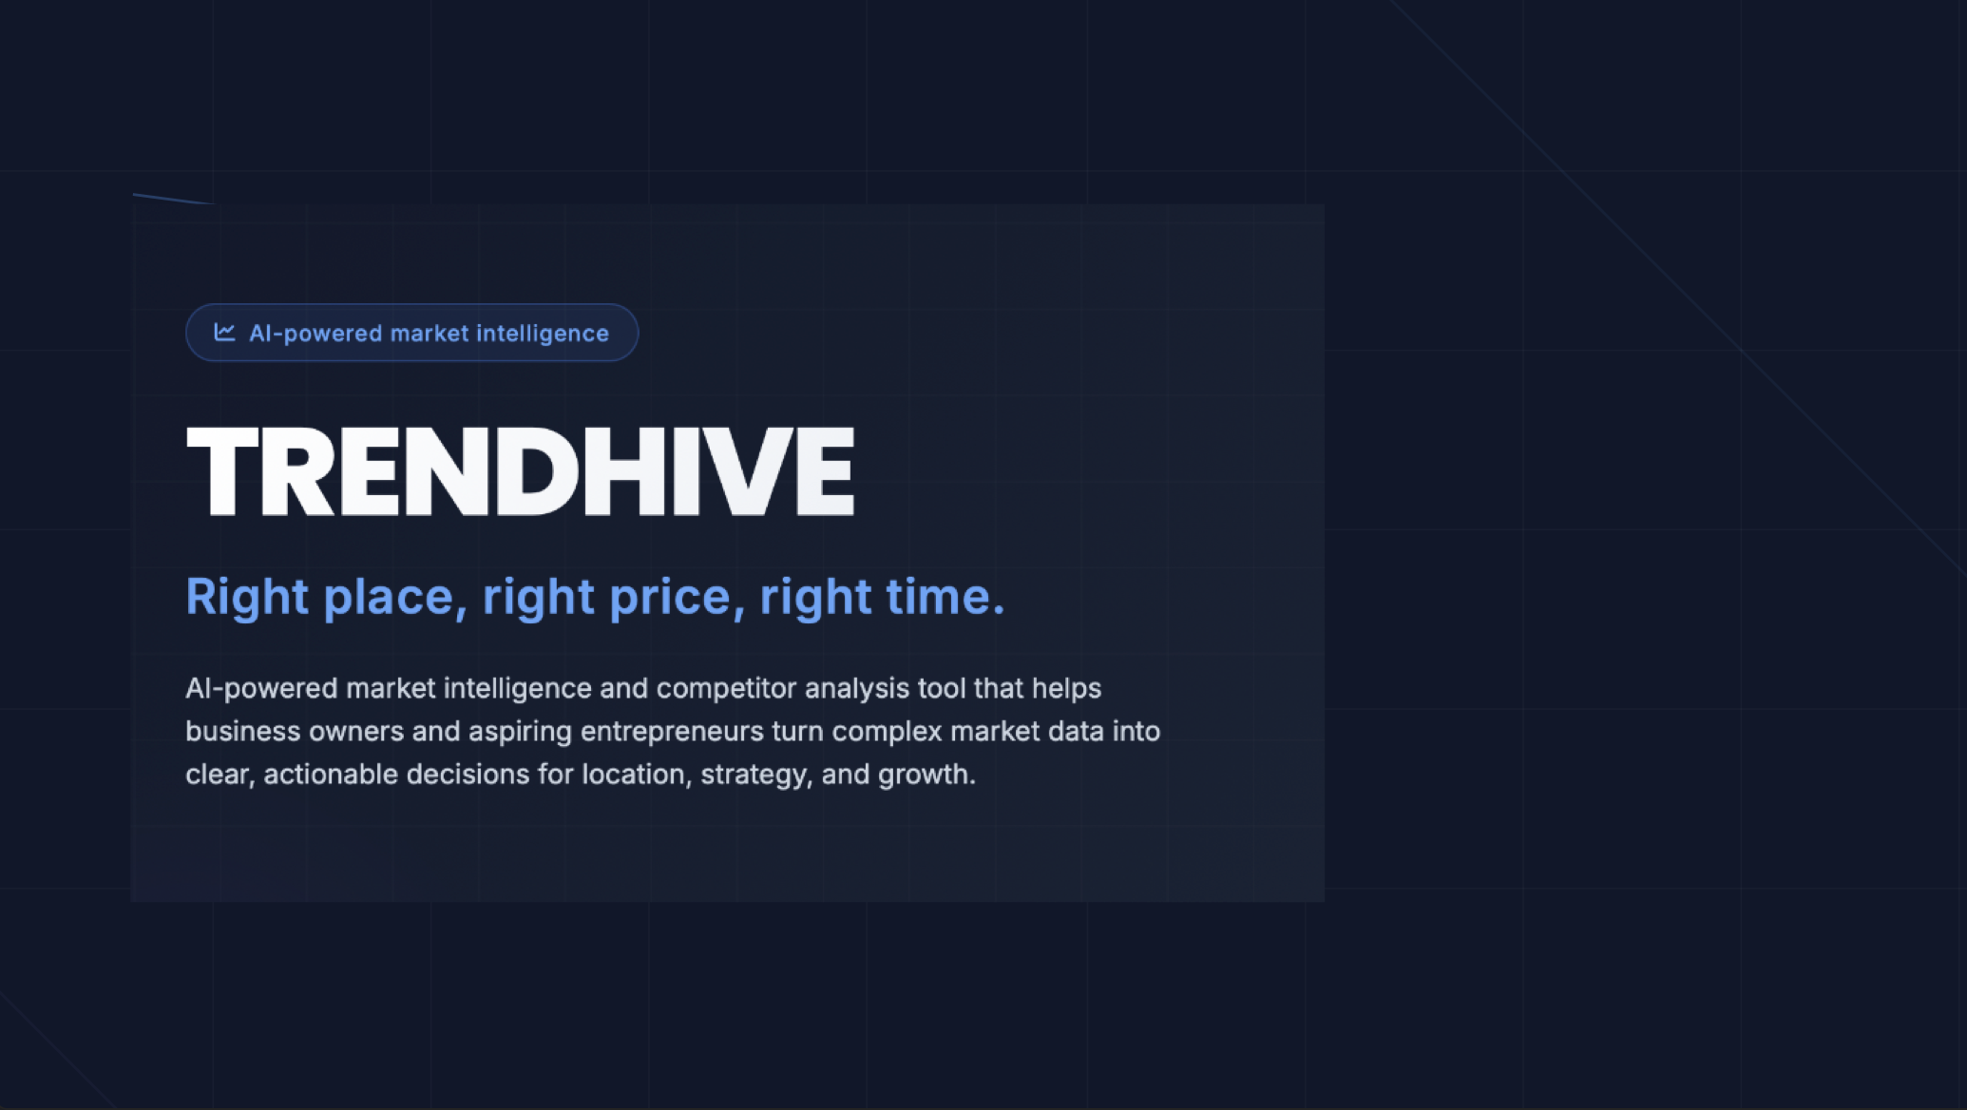

Slide 2
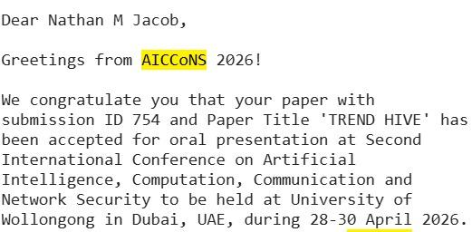
AICCoNS 2026
We are proud to inform you that our paper on TrendHive, has been accepted for oral presentation at Second International Conference on Artificial Intelligence, Computation, Communication and Network Security.

Slide 3

Problem Statement
In today’s highly competitive and rapidly growing business environment, entrepreneurs and business owners face significant challenges in making informed, data-driven decisions.
Critical market insights such as consumer preferences, competitor positioning, location viability, tourism trends, and rental benchmarks are scattered across multiple platforms (e.g., reviews, search trends, geospatial data)
There is currently no unified, accessible system that integrates multi-source data with advanced analytics and explainable AI to provide clear, actionable insights tailored to specific industries.
This creates a critical gap in the market. The lack of a centralized, intelligent platform that enables entrepreneurs to understand market dynamics, evaluate competition, and make confident, data-backed business decisions.

Slide 4









Market Size & Problem Overview
Dubai café market analysis and SME challenges
⬡ Data Integration Challenges
Market Size
Multi-source data
Total Cafés
Google Places, Trends, geospatial, rent benchmarks
$3.2B
4,800+
AI analysis
Industry value ↑ 8%
Highly saturated ↑ 5%
Growth classification & demand forecasting
Smart insights
AI-generated investor narratives
⚠ SMEs Struggle With
No access to advanced analytics
Core Gap
Opportunity
Fragmented data (reviews, tourism, competitors)
No system that combines multi-source data + AI + explainability for café-specific decisions.
Deliver data-driven, explainable intelligence to reduce investment risk in a crowded market.
Reliance on intuition instead of data

Slide 5





Our Solution: TrendHive
AI-driven market intelligence and competitor analysis platform
AI-Driven Market Intelligence Platform
⚙ System Capabilities
Built on comprehensive data analysis of cafés and restaurants across 24 Dubai areas, processing 563,534 real customer reviews to deliver actionable insights.
Growth Classification
Demand Forecasting
AI Insights
Google Places
Google Trends
GROWING / STABLE / DECLINING
6-month horizon
Investor narratives
Geospatial Data
Rent Benchmarks
Cafés Analyzed
Reviews Processed
Output at Scale
4200+
563,534
120 AI-generated narratives (24 areas × 5 investor profiles) with real-time monitoring and actionable insights.
Across 24 Dubai areas
Real customer reviews
120
24
5
Coverage Areas
API Endpoints
24
11+
AI narratives
Areas covered
Investor profiles
Dubai districts
Powering the system

Slide 6
Technologies Used
Frontend
•React (Vite) – Fast, scalable UI
•Recharts – Data visualization (charts & dashboards)
•Context API + React Router – State management & navigation
•Map Integration – Geospatial visualization
Machine Learning & AI
•Random Forest – Growth & popularity prediction
•LSTM (TensorFlow/Keras) – Demand forecasting & trends
•Anomaly Detection – LSTM + statistical methods
•SHAP (XAI) – Model explainability & transparency
Data Engineering
•Multi-source Data Integration
(Google Places, Trends, Geospatial, Rent Data)
•Sentiment Analysis (NLP) – Customer insights
•Feature Engineering & Scoring Models
Backend
•FastAPI (Python) – High-performance REST APIs
•Pandas & NumPy – Data processing & analytics
•Modular Architecture – APIs for analytics, predictions, maps
AI & NLP Systems
• Agentic AI Copilot (decision support)
•DistilGPT-2 – AI-generated business insights
•Hybrid System – AI + rule-based validation
Storage & Deployment
•CSV Data Storage – Processed datasets
•Model Storage – Pickle / Joblib
•Environment Config – Scalable deployment
•Lightweight AI Models – CPU-friendly

Slide 7








Quantified Decision Engine
Data validated
Key metrics for market intelligence and location analysis
94% accuracy
Popularity Score per Area
Competition Index
Rating × log(Review Count) → True demand strength
Café Density + Market Share → 94% accuracy
Captures true demand strength by weighting rating with review volume
Based on café density analysis, validated with 94% accuracy
Area Demand Score
Trend Growth Rate
Popularity − Competition + Tourism
Search Trends × Weekly Data Points → 260/week
Identifies high-return locations by combining multiple factors
Based on search trends with ~260 weekly data points per keyword
Validated Proxies
Footfall score correlation
Rent estimation error
r = 0.82 with real tourism data
~AED 12/sqm MAE

Slide 8



AI Models & Measured Performance
Growth classification and demand forecasting analysis
Growth Classification (Random Forest)
Demand Forecasting (Holt's Model)
87%
0.87
87.2%
5.82
19.9%
7.2%
Accuracy
Weighted F1
Cross-validation
MAE
MAPE
Best Case
↑ 2.3%
↑ 0.05
↑ 1.8%
↓ 0.3
↓ 2.1%
Café near me
Decision Tree
81.2%
"Café near me" → 7.2% MAPE
Best performing keyword
Logistic Regression
0.68 F1
6-month forecast with 92% confidence interval
* Outperforms baseline models with 5.8% higher accuracy
Performance : 4.3/5 rating
💡 Key Insight Drivers (SHAP Analysis)
Sentiment Mean
Positive Review Ratio
Review Volume
0.222
0.159
0.140

Slide 9





Results, Impact & Investor Value
System validation, business impact, and competitive advantages
✓ System Validation
🎯 Business Impact
Café managers rated explanations 4.3/5 for decision usefulness
4.3/5
High-demand locations
Emerging trends
Identify low-competition areas
Matcha, cold brew spotting
Narrative generation <200ms latency (CPU)
<200ms
Risk reduction
Consultant independence
Template fallback <50ms latency
<50ms
Site selection security
Reduce dependence
🏆 Competitive Advantage
Explainable AI
Agent-based monitoring
Café-specific metrics
SHAP transparent decisions
Real-time insights
Domain precision
TrendHive transforms 563K+ data points into actionable investment decisions
563K+
$3.2B
Enables SMEs to compete in a $3.2B market with enterprise-level intelligence
Data Points
Market Size

Slide 10
Thank You
Questions?

